Slide 1
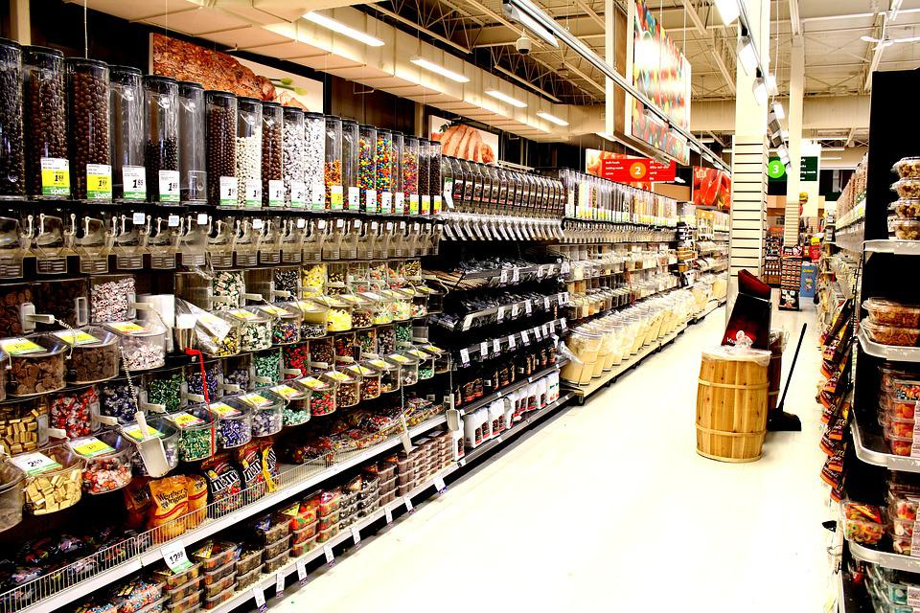

VendGo
A way forward, together
Putting choices in the hands of those that need them

Slide 2
The Problem Statement
“Design solutions for small businesses that can range from Inventory Management, Inventory Tracking, Sales, or any other such use-case for a specific small business of your choice, from a domain of your choice.”
In this case, we have chosen to design a platform for small scale retailers, who usually face issues in buying essential materials from wholesalers due to expensive prices, to split the cost amongst other businesses with same requirements.

Slide 3
The Problem
What exactly is the issue?
The small retailers lack bargaining power as they generally purchase only small amounts of inventory compared to the big retailers. This might make them difficult to get better pricing for their products. They will not be provided with attractive offers by the wholesalers.*
No Autonomy
Partial towards wholesalers
Wholesalers can only gain from these one-sided transactions. They hold the advantage due to the difference in inventory, eliminating the option to bargain
The entire transaction proceedings is at the whim and will of the Wholesale distributor.
Crushes business
Can lead to a loop of un-fulfilled debt, forcing the business to never get off the ground.
Expired Resources
Even if the retailer does purchase from the wholesaler in bulk, the amount bought will always outweigh the ones used, leading to wastage
* From A Study on The Problems Faced by Small Retailers in India, Elsa George

Slide 4
Our mission
Absolute Impartiality
Our solution plans to even the playing field by allowing multiple retailers to band together to post a bulk request on our platform, which will appear as a single bulk request to a verified wholesale distributor. The procured items will be transported by an outsourced third party. Payment for delivery from client side, with payment for materials divided depending upon quantity ordered.
As long as both retailers and vendors are able to provide valid proof of business, they are eligible to post and participate in merged requests
Facilitate Wholesaler-Client Relationship
This model results in a mutually beneficial relationship between a single large supplier and multiple small businesses, leading to improved communication, facilitated by both being registered on a single platform.
Outsourced activities
Certain core activities pivotal to the functioning of small businesses, can be outsourced to third parties, such as transportation. This can be organized through our platform

Slide 5
How?
How to implement such a solution?

Slide 6
Registration
Having both retailers and wholesalers on a common platform will ensure adaptive, accommodating, excellent communication.
01
02
03
Posting Requests
Delivery
A retailer can post a request consisting of material, quantity, and specified vendor.
It will show up as a result for other retailers which they can actively participate in.
The order is delivered through a third party after payment is made and the quota is completed. The platform earns profit from interest

Slide 7
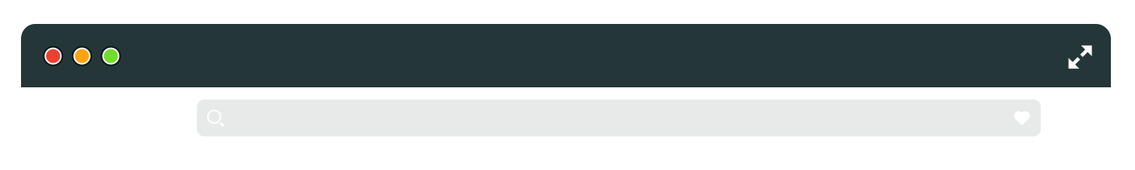
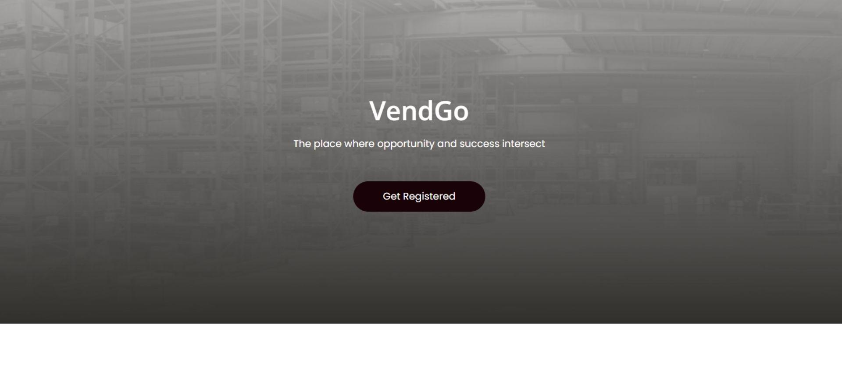
Browser Mock Up
A sneak peek at good things to come
www.vendgo.com

Slide 8
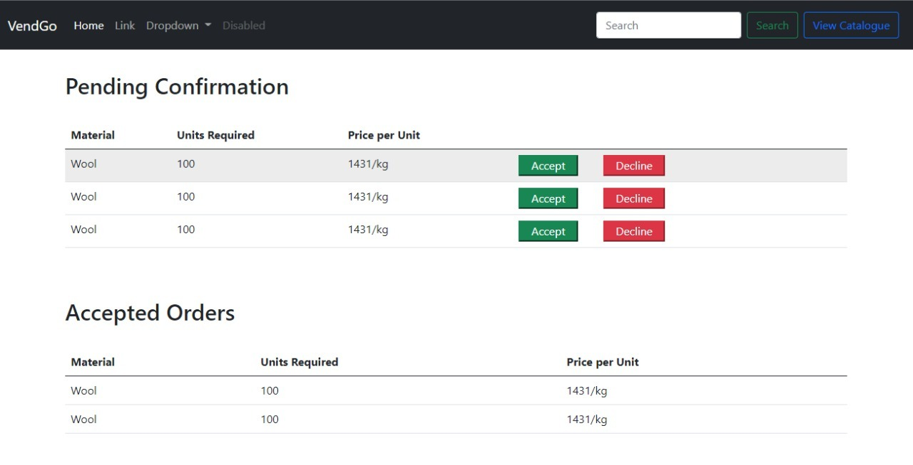
Vendor’s Dashboard
www.vendgo.com

Slide 9
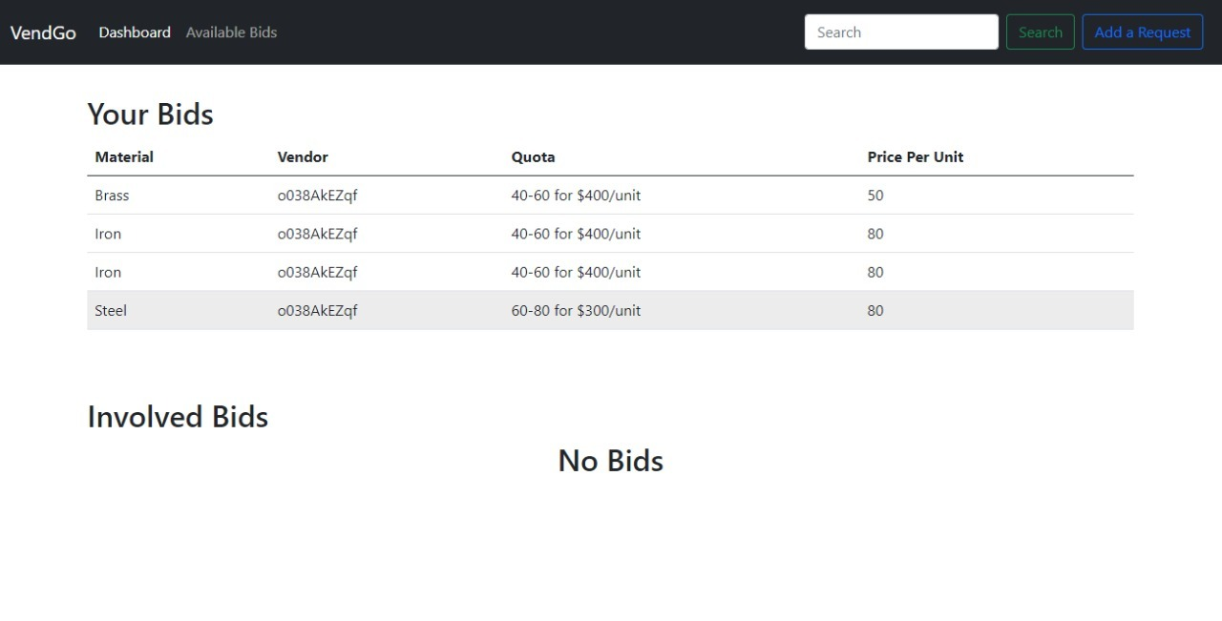
Retailer’s Dashboard
www.vendgo.com

Slide 10
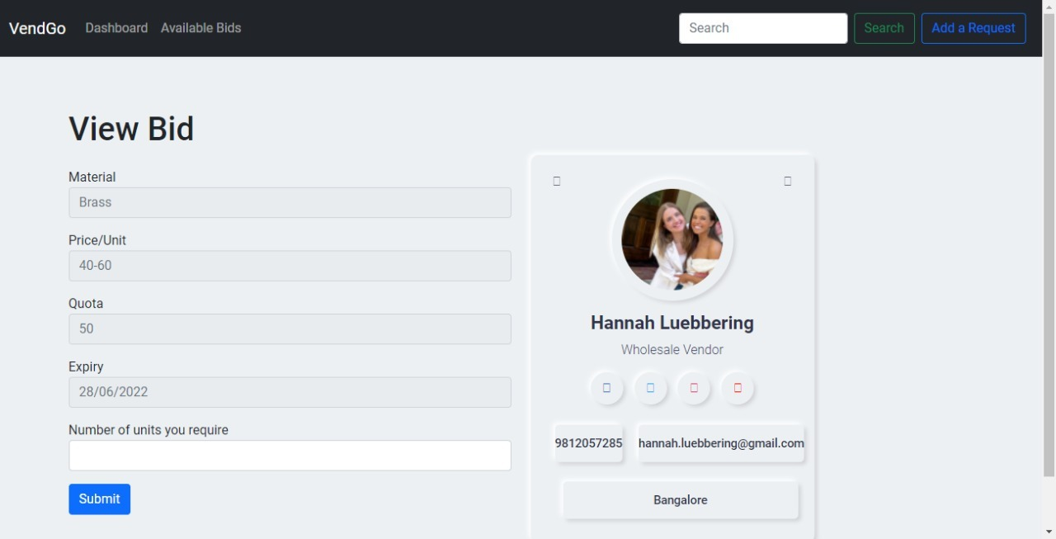
Bidding Screen
www.vendgo.com

Slide 11
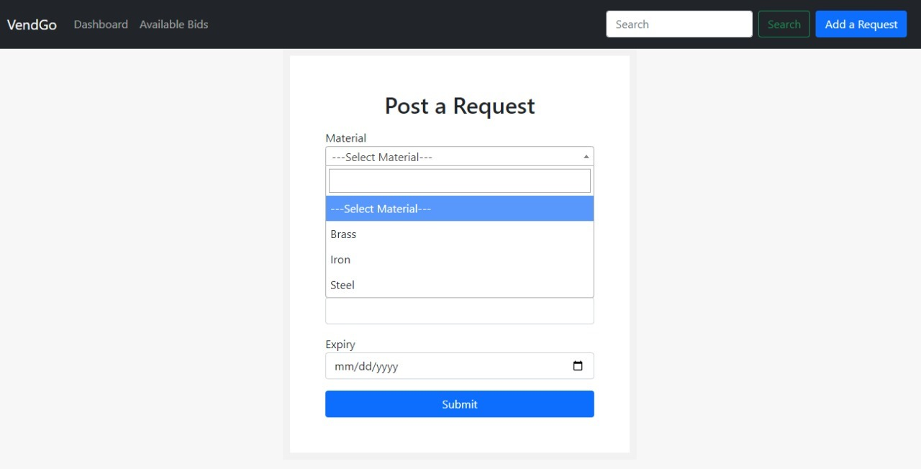
Post a Request
www.vendgo.com

Slide 12
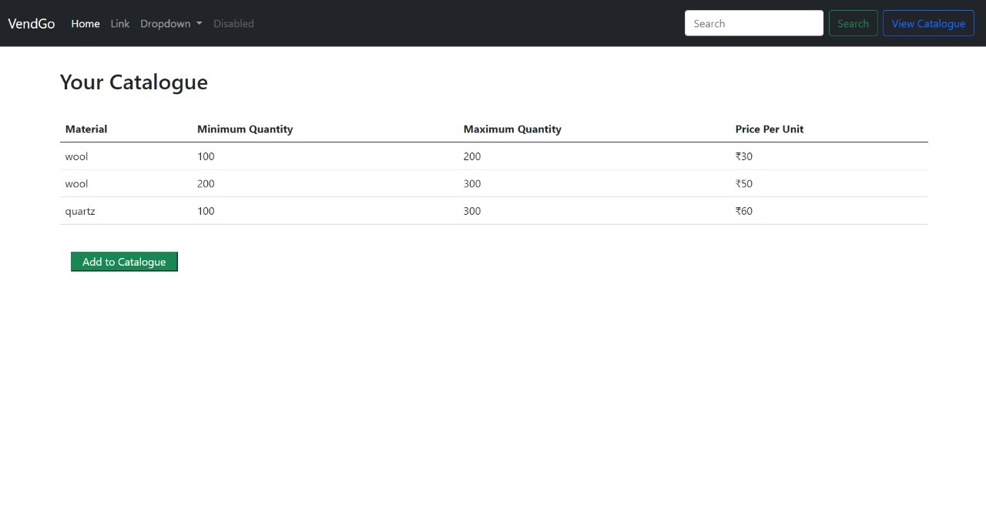
Catalogue
www.vendgo.com

Slide 13
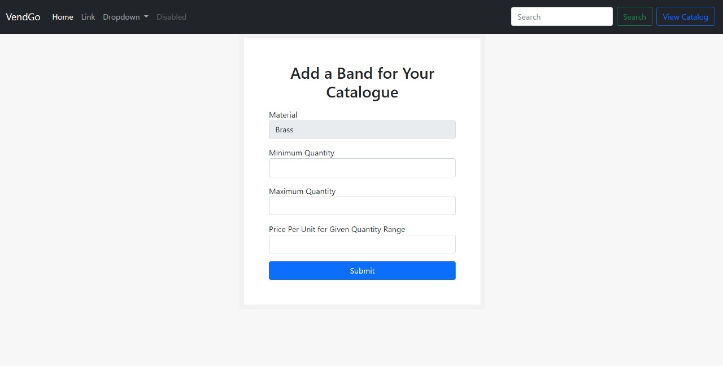
Add Catalogue
www.vendgo.com

Slide 14
Meet the team
Malhaar Arora
Spandan Panda
Rushiraj Gadhvia
Aditya Tyagi

